Slide 1
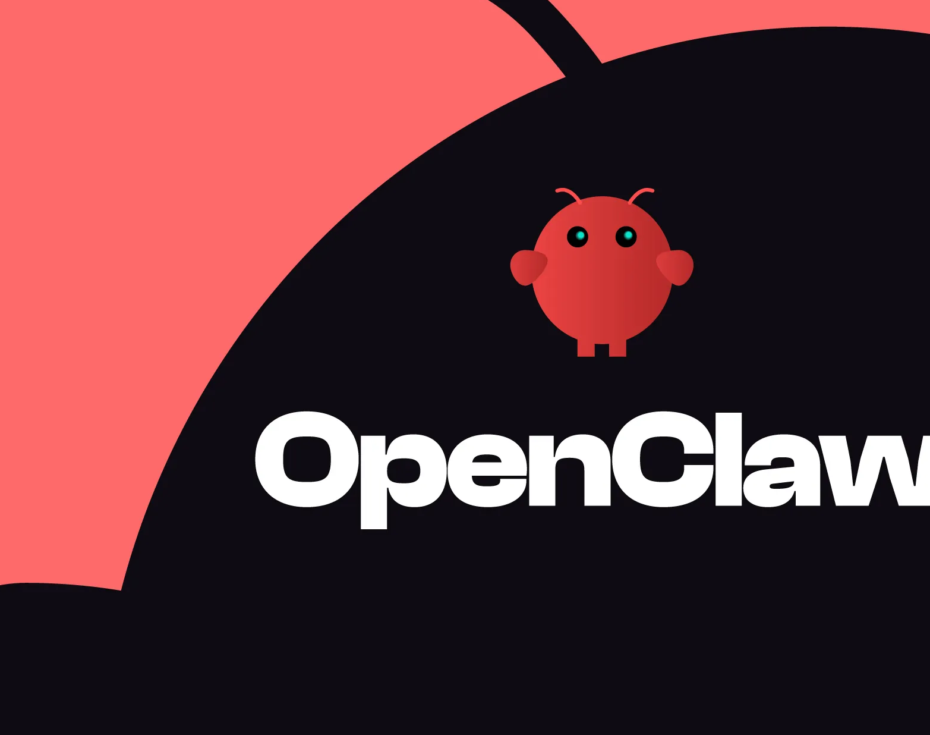
Open Claw
Data SAIL - Tech News

Slide 2

What is it?
It is a 24/7 available AI employee who really works independently.
It was launched at the end of 2025.
Open source, you can find its code on Github (+200k stars)
Runs locally
Peter Steinberger is its creator
It does not provide a model; it provides the brain wiring.

Slide 3

Naming history
Clawdbot
The naming is like Claude’s API, which the tool uses.
Cease and desist
Anthropic complains about the naming similarities.
Modeboard
Open Claw
Final naming decision
Weird renaming, it will not last for long.

Slide 4

The Mac mini demand
The rise in this tool’s popularity was acompanied by a rise in Mac Mini demand.
”Affordable” ($600-700) and powerful option to run OpenClaw nonstop.
Is it the best option? On most cases, probably not.
You can rent a virtual private server to do the same for $20-30. It would take you more than 20 months to end up paying the same!
What about your own laptop?

Slide 5
What can it be used for?
Daily news digest → Get daily summaries of new videos from your favourite channels.
Goal-driven autonomous tasks → State your goals and make it generate, schedule and complete tasks.
Telegram access → Access OpenClaw from any phone via Telegram.
Get a morning brief → Get a fully customized daily briefing from your own data, including to-do's, emails received…
Market research → Mine for data on the stock market for opportunities to analyze.

Slide 6

Risks
OpencClaw has existed for a little over 3 months. It is not a finished product.
It is a developer tool. You will need to configuer things with a required technological background.
There are security risks!
It can have access to your entire ecosystem.

Slide 7
How to mitigate risks?
If you consider yourself to be techy enough for this project and want to work with this tool you must consider:
Treat it like an intern. Would you give it access to EVERYTHING on its first day of work?
Start configuring it with read-only access.
Gradually expand its capabilities.

Slide 8
Costs involved
You will need specialized hardware. The two most common options are a VPS ($20-30/month) or a Mac Mini ($600-700).
You will require an AI API key (it can be Anthropics, Sonet, …). This will be a cost that you will have to regulate.
Also consider a possible ROI, how much is your time worth? How much of that time can you save by actively using this tool?

